Slide 1
SPRITE

Slide 2
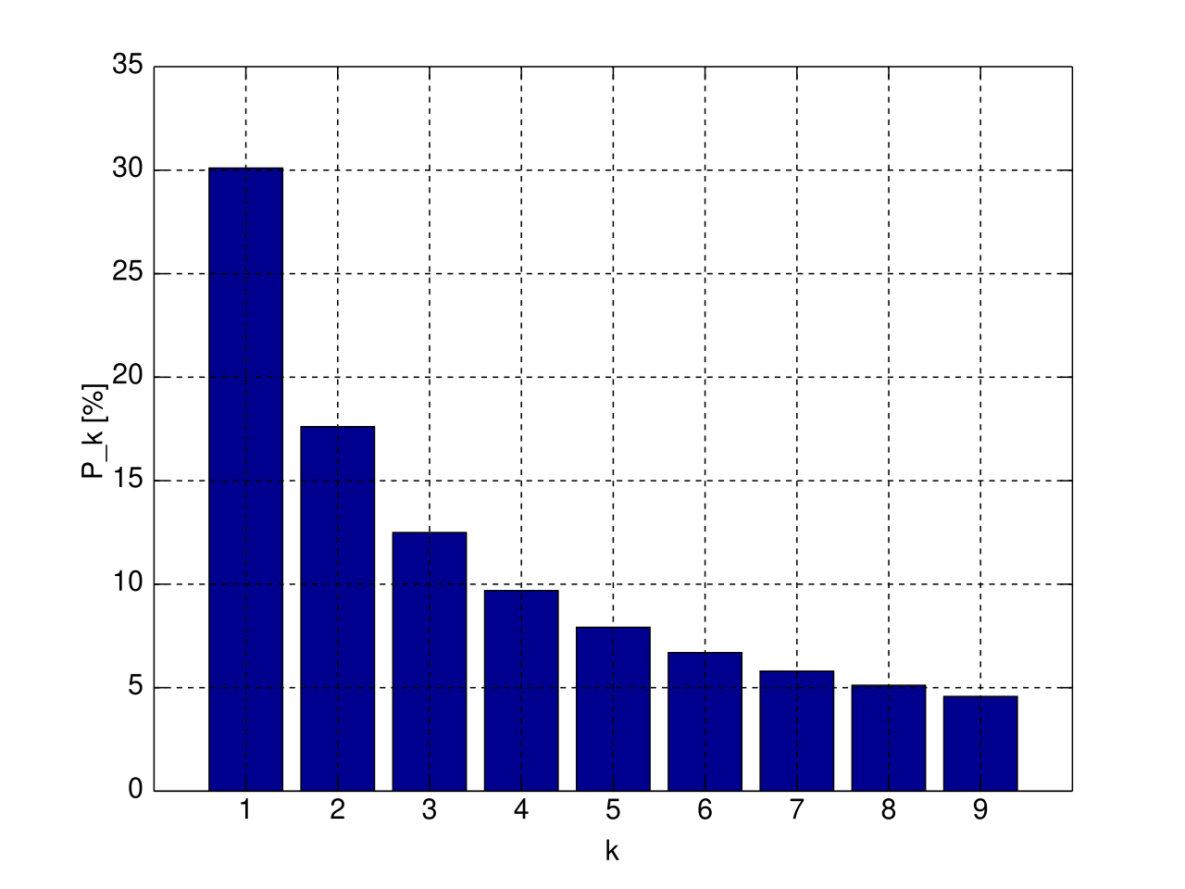
Benford’s Law
A set of numbers is said to satisfy Benford's law if the leading digit d (d ∈ {1, ..., 9}) occurs with probability:

Slide 3
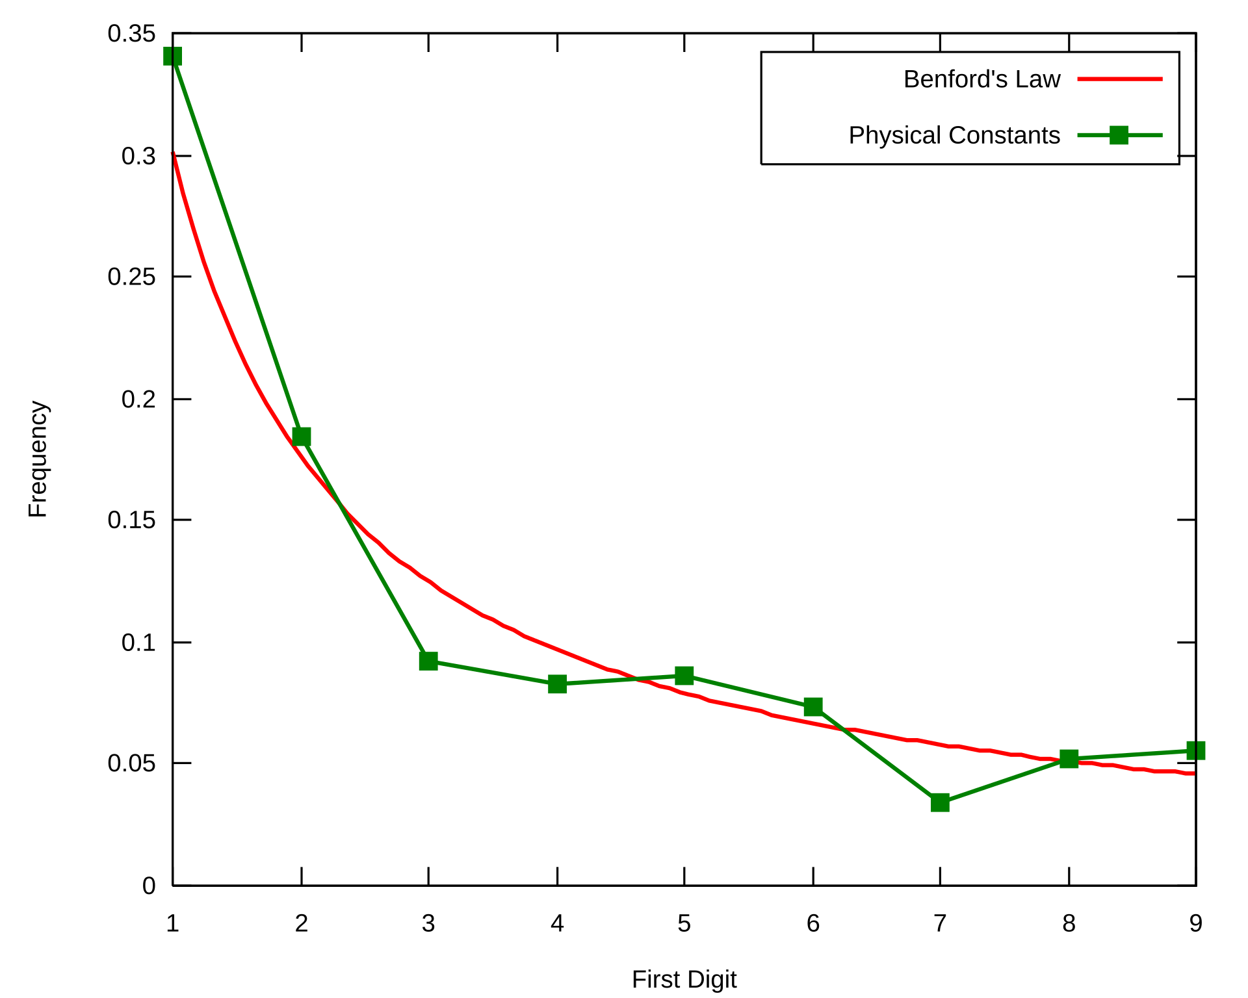
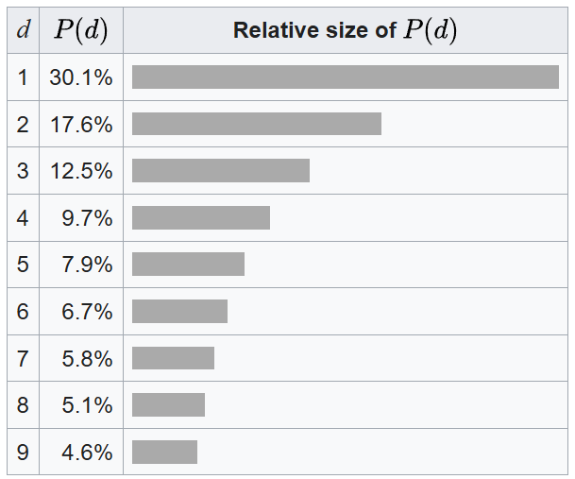
Forensic Accounting Application

Slide 4
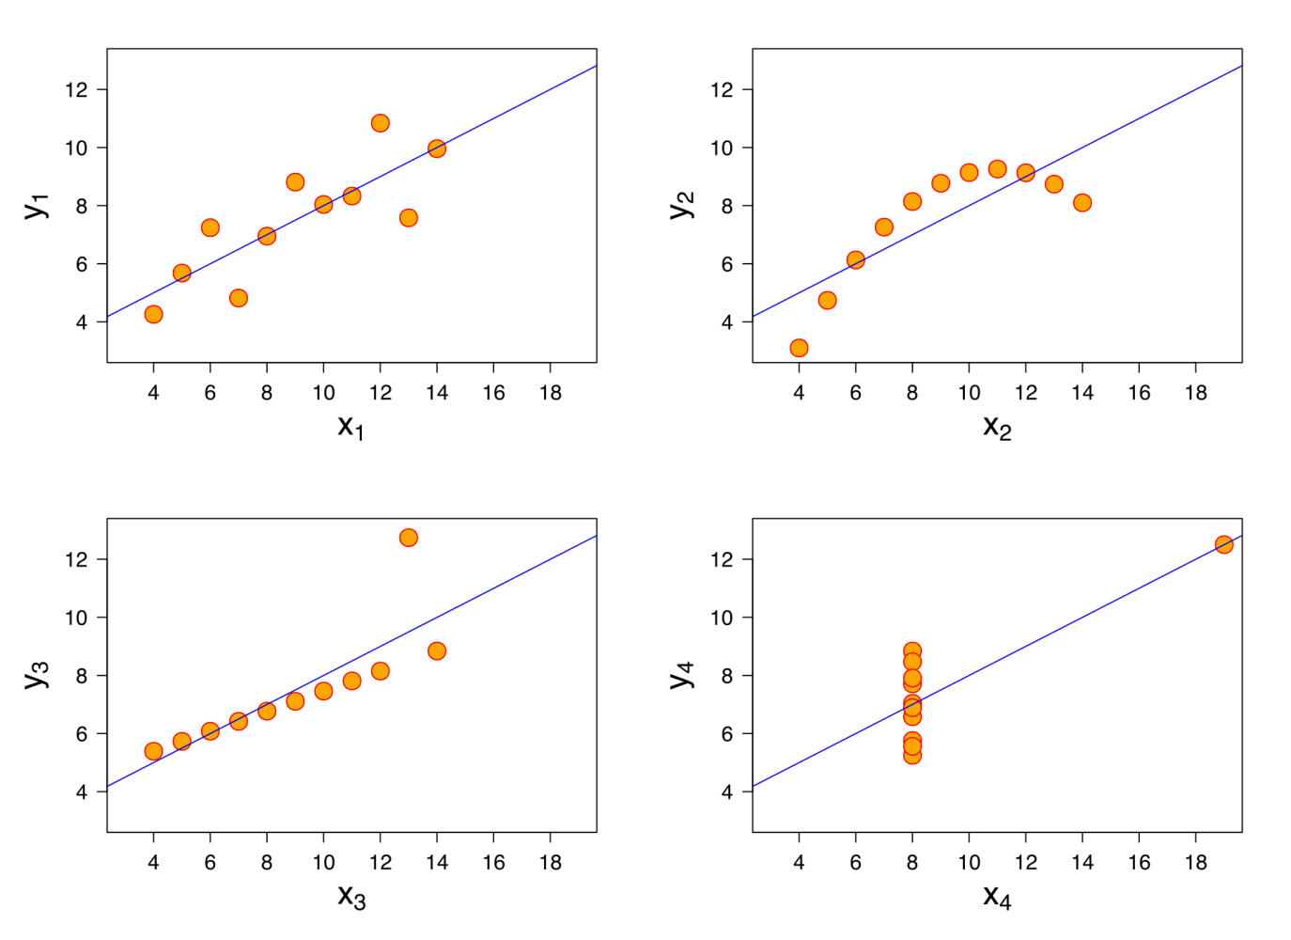

Slide 5
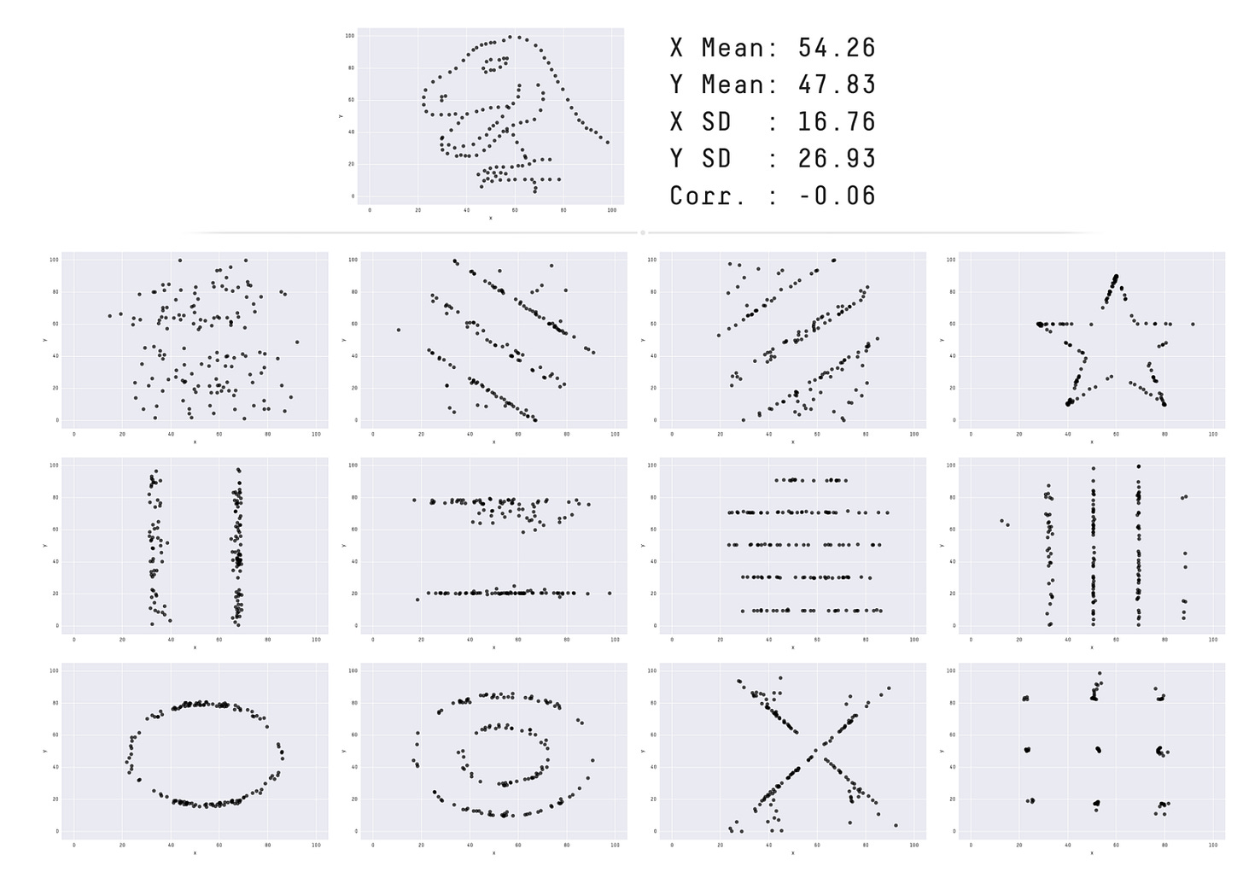

Slide 6
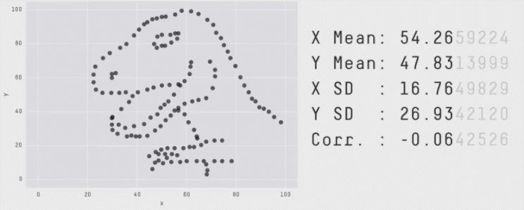
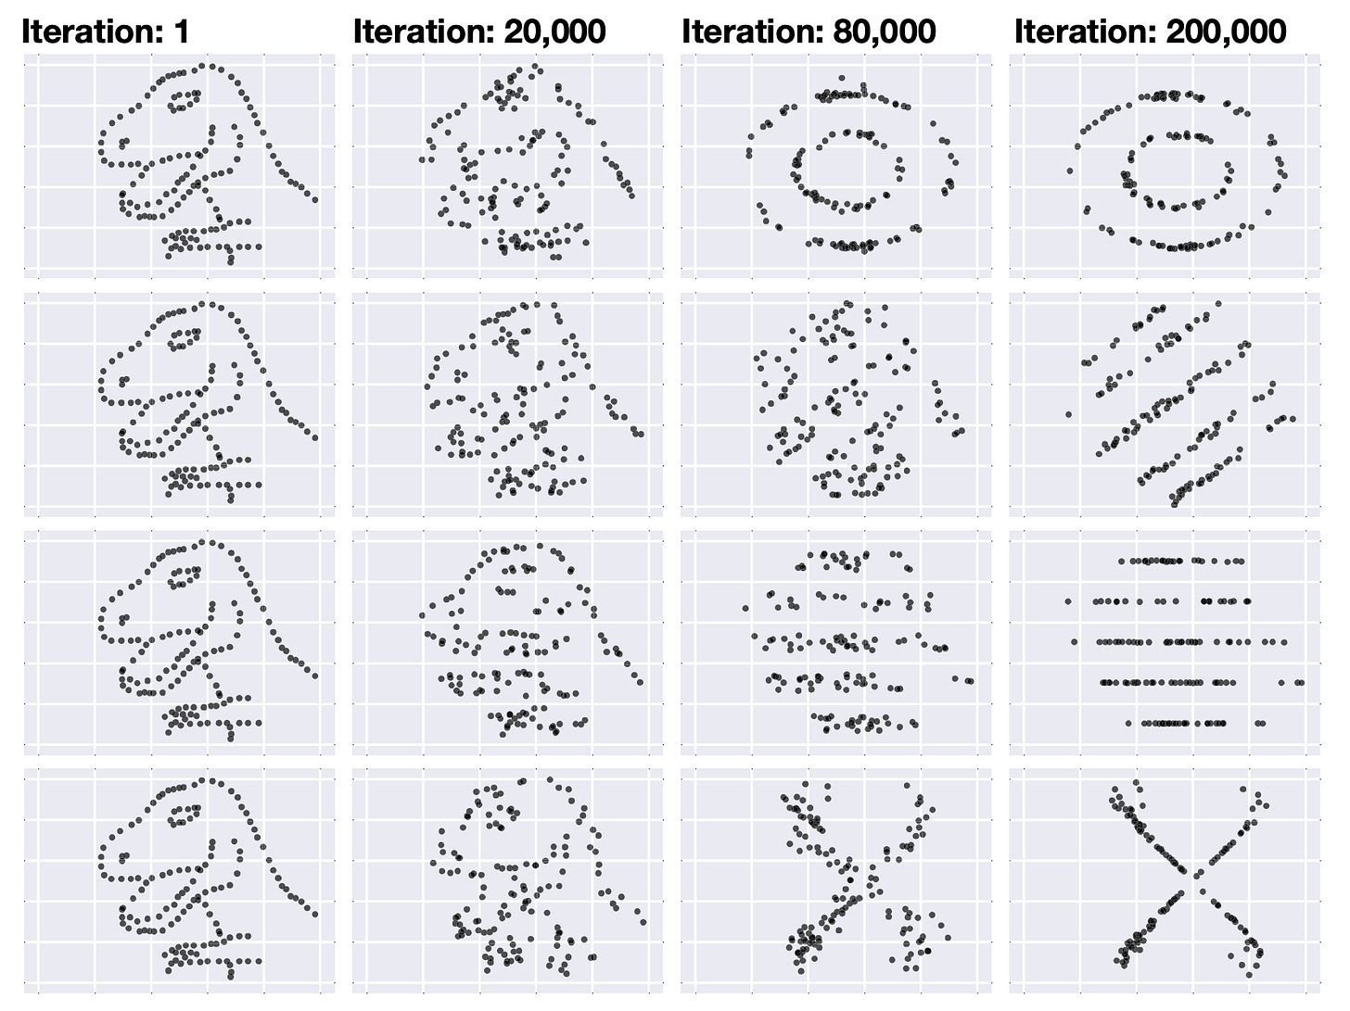

Slide 7
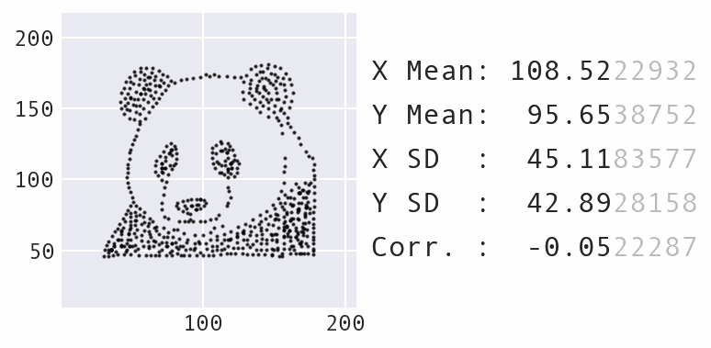

Slide 8
test
tq
ses
csize

